Slide 1
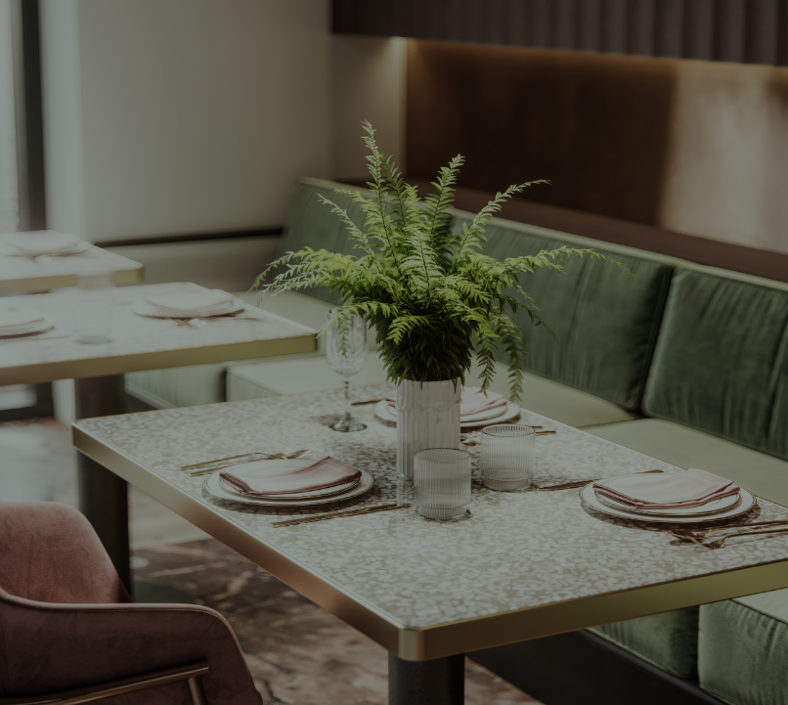


Go grocery
Guided By-
Prof. Kiran Tiwari.
Presented By-
Onkar Vhanmane.
Rutuja Gotarne.
Pooja Yerrabalam.​​
Manasi Dhavale.
Pitch

Slide 2

overview
Aim
Objectives
Entities
ER-Diagram
Technology Stack
Project Features
Back-End Architecture
Front-End Architecture
Demo Screenshots
Future Upgradation
Conclusion
About

Slide 3

Aim of project
The Aim of Project is to Provide Customers with a Convenient Platform to Purchase Groceries from the comfort of their Homes, saving them Time & Efforts.
Utilize customer data to personalize recommendation, promotion and discounts based on shopping habits and preferences.
Guarantee the freshness and quality of products through careful sourcing,storage and handling procedures.
Provide Excellent customer services,including responsive support channels for inquiries,complaints and feedback.
Sustainability means implement environmentally friendly practices,such as reducing packaging waste,promoting reusable shopping bags and sourcing from eco conscious suppliers.

Slide 4
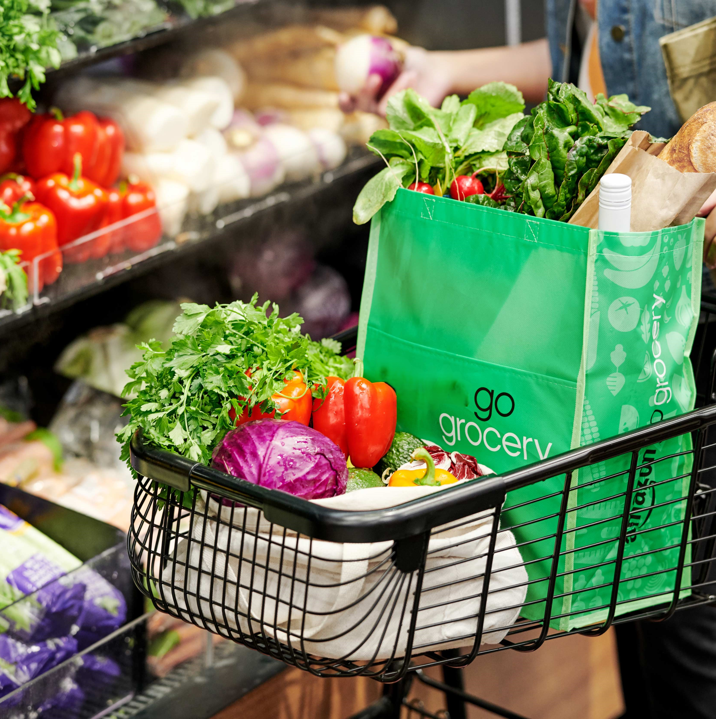
OBJECTIVES
Increase Revenue-
Expand the customer base by reaching more online shoppers.
Implement marketing strategies to attract new customers and retain existing ones.
Enhance Customer Experience-
Provide a user-friendly and intuitive online shopping platform.
Offer personalized recommendations based on shopping history and preferences.
Operational Efficiency
Streamline order processing and inventory management.
Integrate with suppliers for real-time stock updates and efficient restocking.
Market Expansion
Launch the service in new geographic areas.
Introduce new product categories based on market demand.

Slide 5
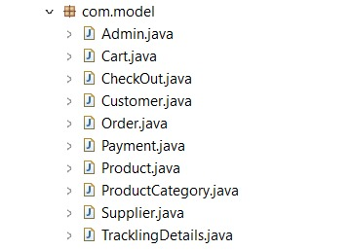
Entities

Slide 6
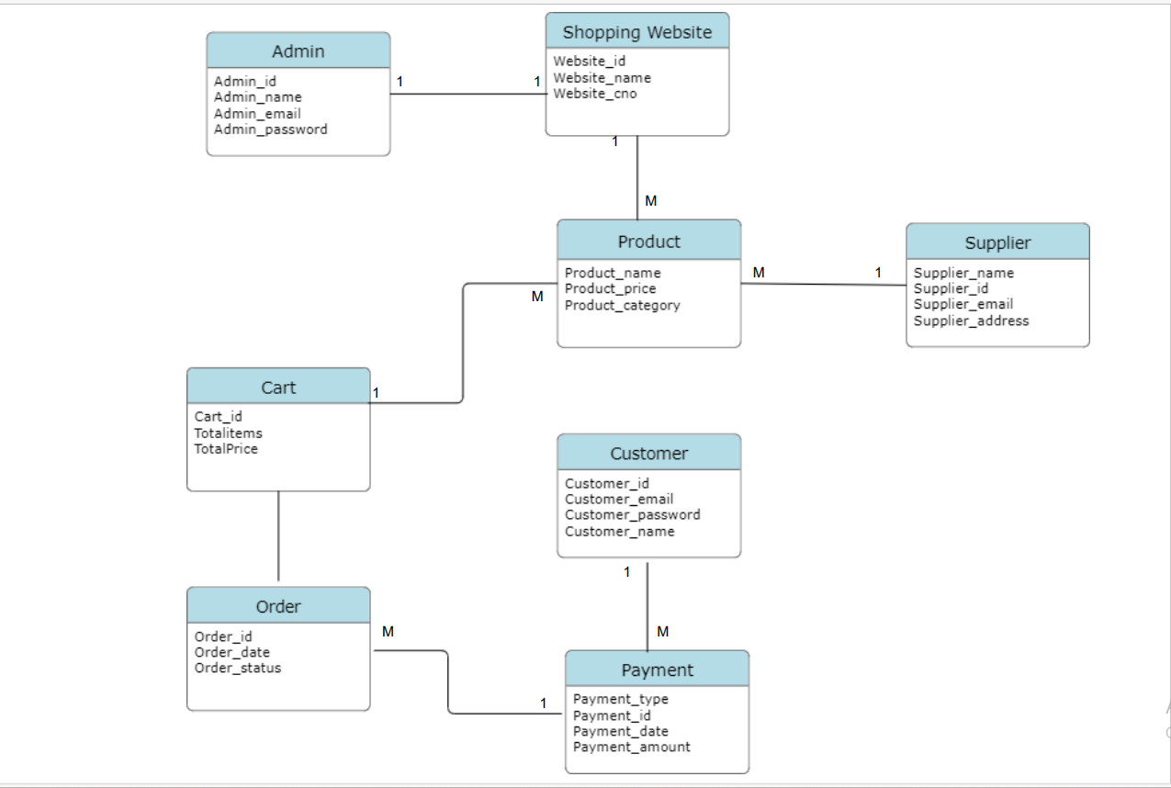
Er-Diagram

Slide 7
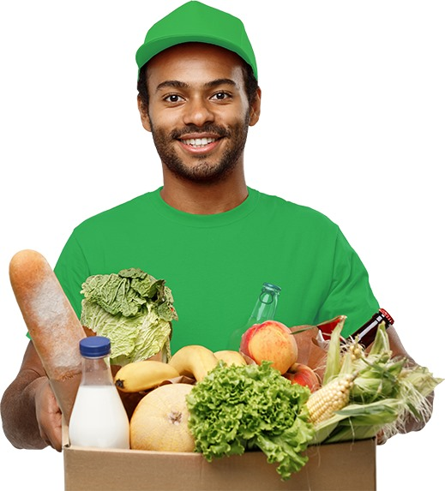
Technology stack
HTML-
HTML(Hyper Text Markup Language) is the code that is used to structure a web page and its content.
CSS-
CSS(Cascading Style Sheets) is used to style and layout web-pages for example, to alter the font , color, size and other decorative features.
ANGULAR-
Angular is a platform and framework for building single page client applications using HTML and Typescript Angular is written Typescript.
SPRINGBOOT & MYSQL-
Spring boot and MySQL are commonly used together in building strong and scalable web applications.

Slide 8
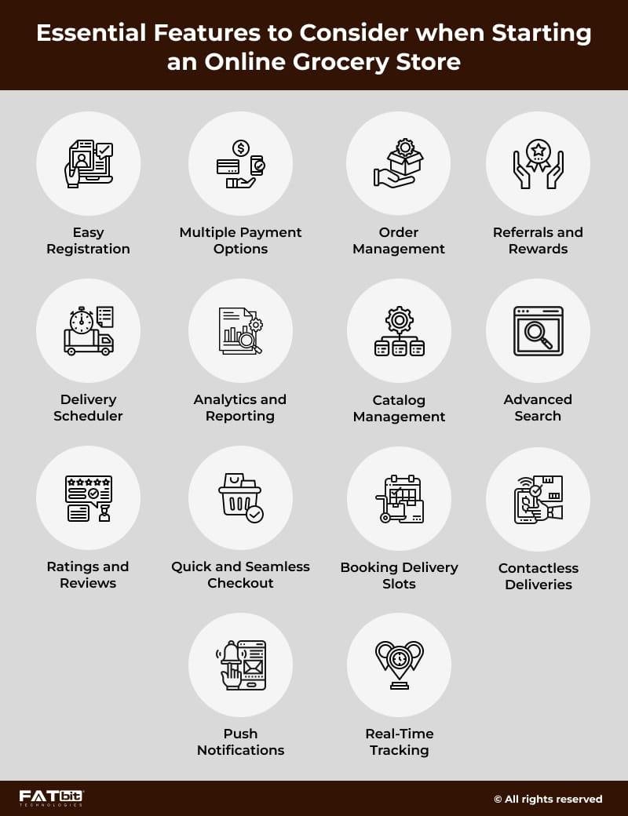
PROJECT FEATURES

Slide 9
JPA MAPPING(RELATIONS)
entity relationships define how entities (representations of database tables) relate to one another. These relationships are crucial for effectively managing the underlying database schema and ensuring data consistency.
1. One-to-One (@OneToOne)
A one-to-one relationship is where one entity instance is associated with one instance of another entity.
2. One-to-Many (@OneToMany)
A one-to-many relationship is where one entity instance is associated with many instances of another entity.
3. Many-to-One (@ManyToOne)
A many-to-one relationship is where many instances of an entity are associated with one instance of another entity. This is the inverse of the one-to-many relationship.

Slide 10
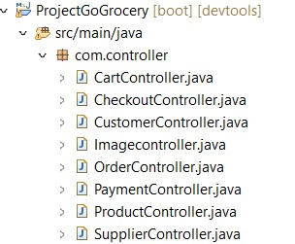
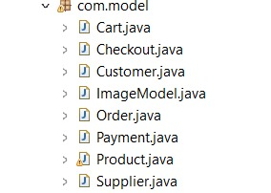
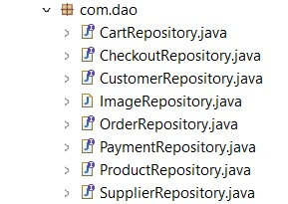
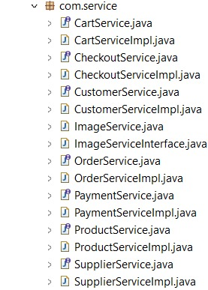
BACKEND ARCHITECTURE
ENCAPSULATION-
Wrapping up of data member & member functions in single unit.
ABSTRACTION-
Hidding implementation &
Showing functionality.

Slide 11
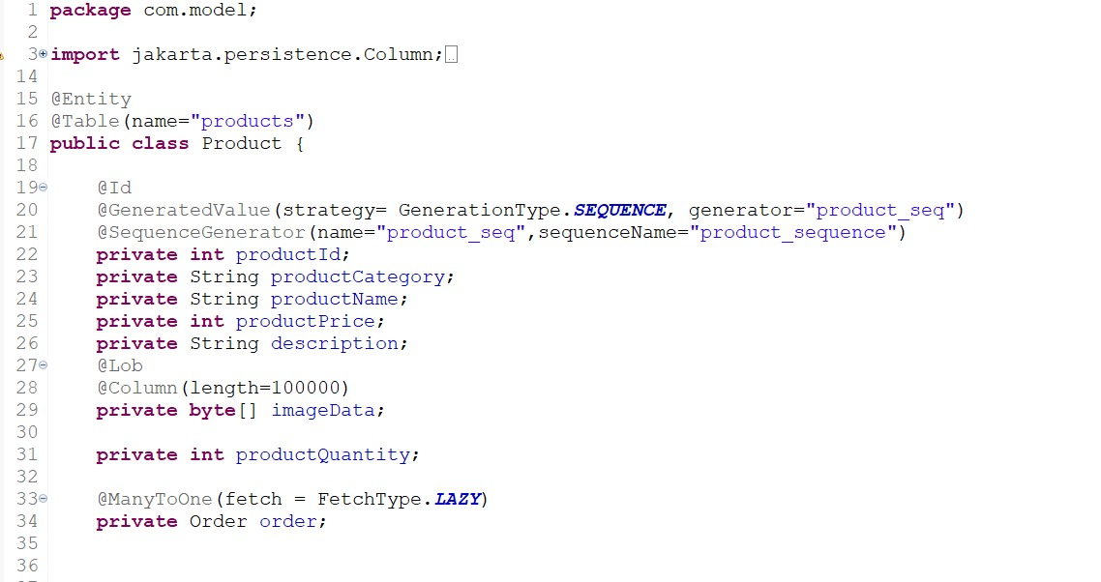
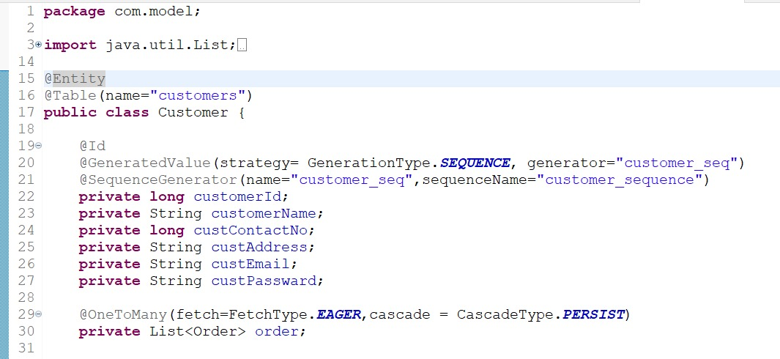
BACKEND ARCHITECTURE JPA MAPPING

Slide 12
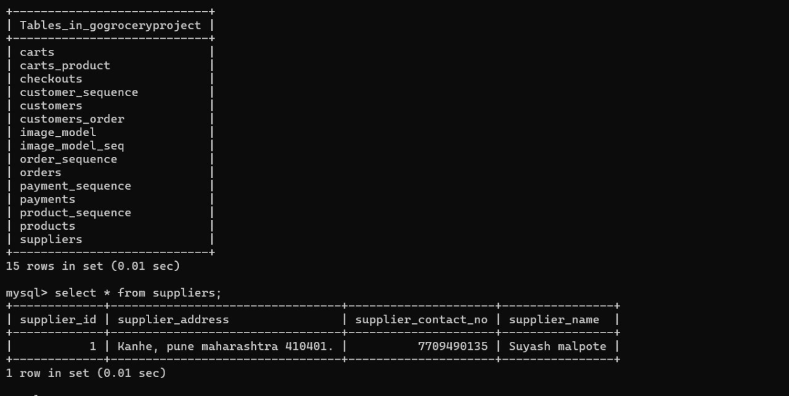
Backend architecture MYSQL(DATABASE)

Slide 13
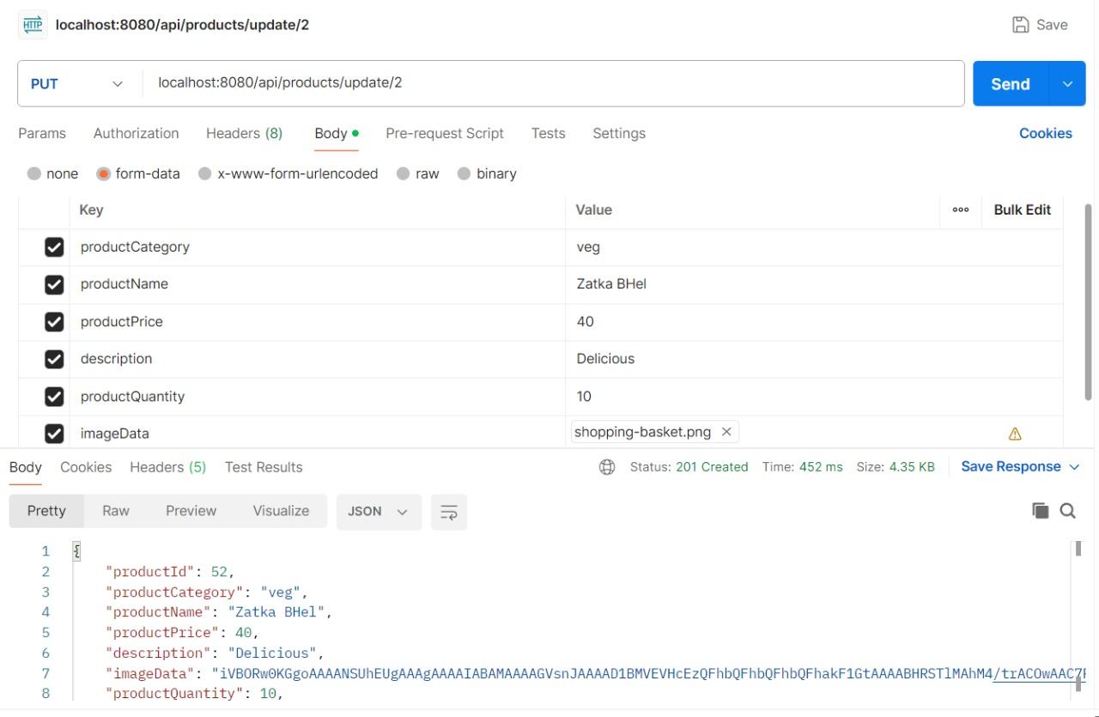
Backend Architecture
POSTMAN-
Postman is an application used for API testing.
METHODS-
GET
POST
PUT
DELETE

Slide 14
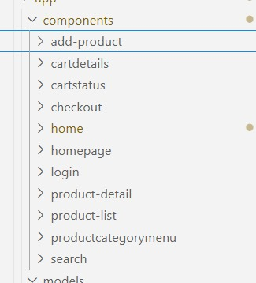
FRONTEND ARCHITECTURE

Slide 15
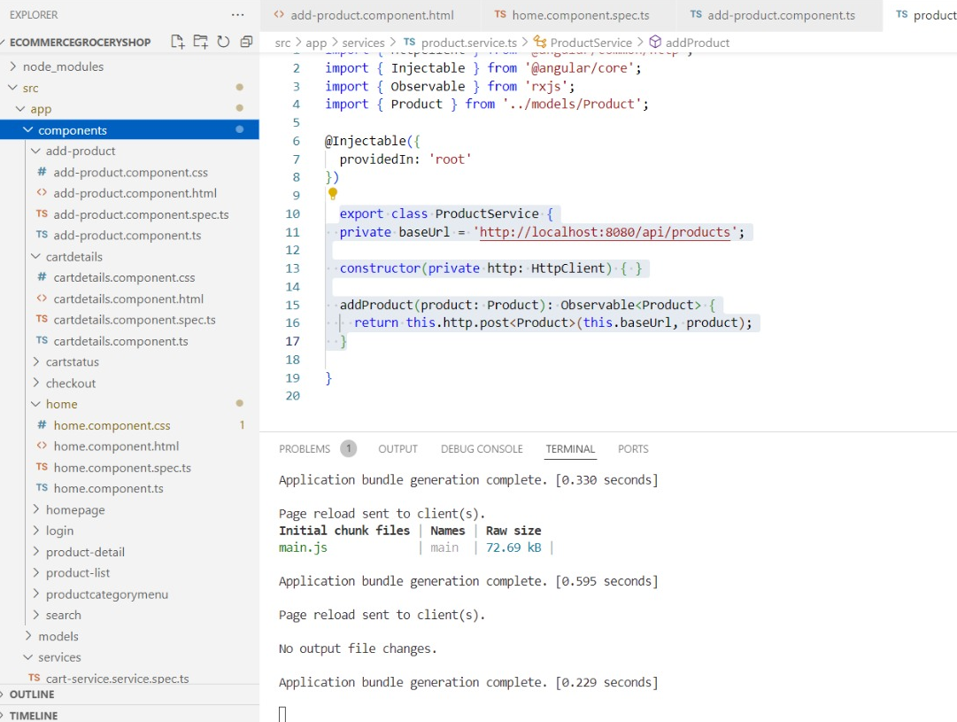
FRONTEND ARCHITECTURE

Slide 16
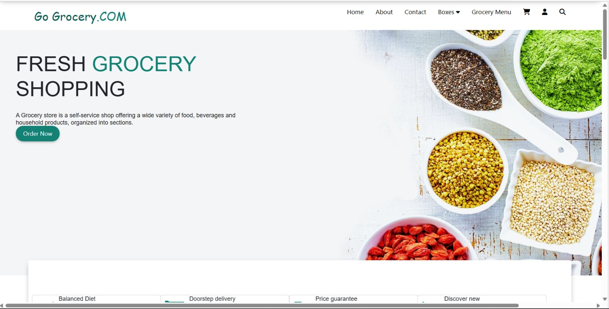
DEMO SCREENSHOTS

Slide 17
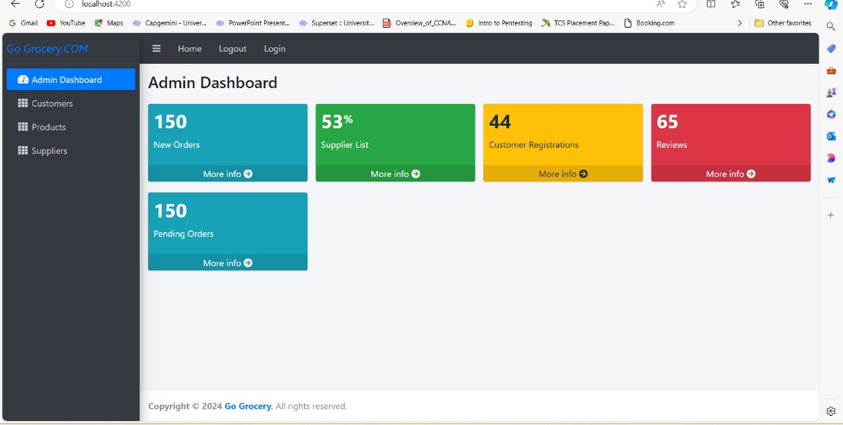
DEMO SCREENSHOTS

Slide 18
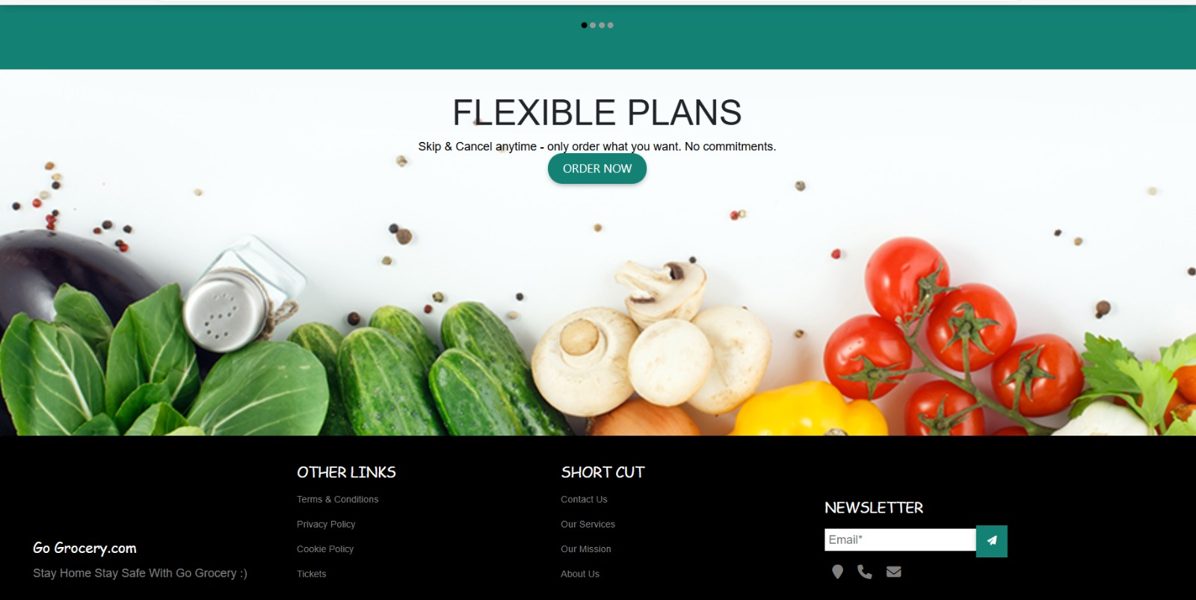
DEMO SCREENSHOTS

Slide 19
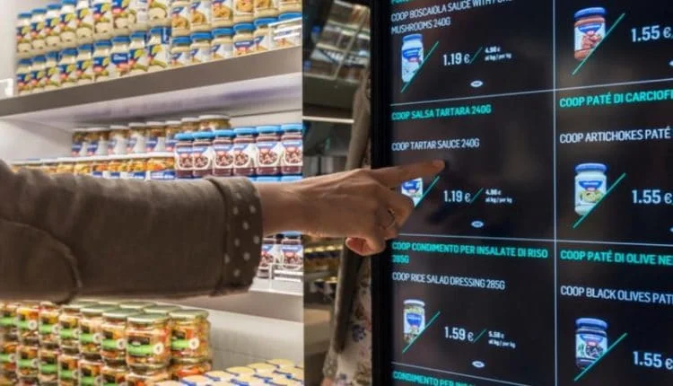
Future upgradation
Voice activated shopping.
Utilization of AI & Machine Learning Algorithms to analyse customer data.
Social commerce Integration.

Slide 20

Conclusion
Company

Slide 21

In Conclusion, the grocery online shop industry continues to evolve rapidly, driven by advancements in technology, shifting consumer preferences and market dynamics.The emergence of online Grocery shopping is depends on the way people purchase essential items, offering flexibility and accessibility.
However, the success of grocery online shops depends on various factors, including user experience, product quality, delivery efficiency, and customer service. To thrive in this competitive landscape, online retailers must prioritize continuous improvement and innovation.
Despite the challenges and complexities inherent in the grocery sector, the future outlook for online grocery shops remains promising.

Slide 22




Meet the team
Team
Onkar vhanmane​
Rutuja gotarne
Pooja yerrabalam​
Manasi dhavale​​

Slide 23

THANK YOU!

